Slide 1

The Varsity Blues Spirit

Slide 2
What is the Problem
Audience feel they are disconnected from the teams
Notes:
Why? They did a focus group and found that athletes are intimidating

Slide 3

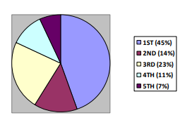
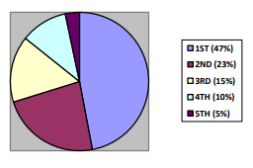
Mission
Building a Sense of Community for First Year Students
2016
2017
Notes:
Fall 2017/18 16899 fy students from all of UOFT
Through school spirit
Hard to change the attitudes of older students
If we get them involved early, they will more likely be involved later on

Slide 4
Value Proposition
Develop the Personality of the Players to Bridge this Gap
Player profiles
Social media
Student engagement during major events
Notes:
Behind the scenes Look for players
Profiles on social media of videos about their stories, and we will build a narrative for them
They Athletes can engage with audience through frosh week, major events, and live streams

Slide 5

Value Proposition
“Additionally, previous studies have predicted that persons with a high level of identification with a target team would be more interested in attending a game involving that team than those with a low level of identification.”

Slide 6

Usage Case
John is a First year student and he feels uncomfortable on campus because its his first time in university and he’s first generation university student. He wants to make friends and get involved on Campus but doesn’t know how and he feels socially awkward. He wants to feel a part of the community but doesn’t know how to.
By attending Varsity Games, he can meet new people, have a common interest with others, and cheer with his new friends for their favorite team. More importantly feel a part of the school.
Notes:
Mention that sports is a common interest shared by a lot of people. There are a lot of ppl likes sport gatherings

Slide 7
The Timeline
Notes:
We have a plan that follows a specific timeline

Slide 8
Big Game
August
Frosh
Build Up
Mass Marketing
Notes:
August
Rosters have been finalized
Start marketing by posting player profiles and creating a narrative for the team and each player
This profile consists of:
Their story which will have their challenges and triumphs
Ambitions
Why?
Because it will give students an idea of who they are cheering for. Also to make them more human
Frosh is one of the biggest events
A lot of first year students
A way to showcase the teams
Example: Show the Football team scrimmaging, playing music, teach them how to cheer, build hype and enthusiasm.
Its hard to bring people to the game, so we’ll bring the game to them
Give them a taste of the atmosphere of a game
If you ever goto a live show on vid
Live stream of practices and scrimmages
Why?
Give them the behind the scenes look of the team preparing and the current skill levels of each player

Slide 9
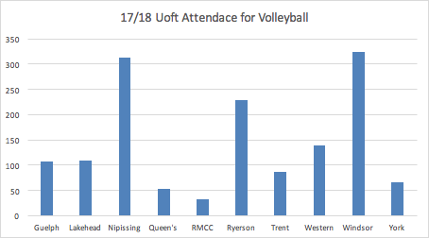
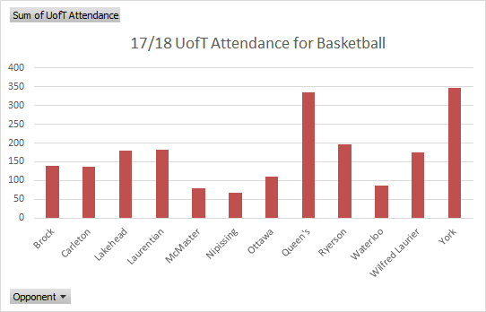

Slide 10
Big Game
August
Frosh
Build Up
Mass Marketing
Notes:
August
Rosters have been finalized
Start marketing by posting player profiles and creating a narrative for the team and each player
This profile consists of:
Their story which will have their challenges and triumphs
Ambitions
Why?
Because it will give students an idea of who they are cheering for. Also to make them more human
Frosh is one of the biggest events
A lot of first year students
A way to showcase the teams
Example: Show the Football team scrimmaging, playing music, teach them how to cheer, build hype and enthusiasm.
Its hard to bring people to the game, so we’ll bring the game to them
Give them a taste of the atmosphere of a game
If you ever goto a live show on vid
Live stream of practices and scrimmages
Why?
Give them the behind the scenes look of the team preparing and the current skill levels of each player

Slide 11
Recap

